Slide 1
System Life Cycles
Requirements
Analysis
Design
Refinement and Coding
Verification
  Correction proofs
  Testing
  Error Removal

Slide 2
Algorithmic Decomposition vs Object Oriented Decomposition
Algorithmic Decomposition: view software as a process, break down the software into modules that represent steps of the process. Data structures required to implement the program are a secondary concern.
Object-Oriented Decomposition: view software as a set of well-defined objects that model entities in the application domain.
  Advantages
    encourages reuse of software
    Allow software evolve as system requirements change
    More intuitive

Slide 3
Object-Oriented Design
Based on Object-Oriented Design with Applications by Grady Booch:
  Definition: An object is an entity that performs computations and has a local state. It may therefore be viewed as a combination of data and procedural elements.
  Definition: Object-oriented programming is a method of implementation in which
    Objects are the fundamental building blocks.
    Each object is an instance of some type (or class).
    Classes are related to each other by inheritance relationships. (Programming methods that do not use inheritance are not considered to be object-oriented.)

Slide 4
Object-Oriented Design
Definition: A language is said to be an object-oriented language if
  It supports objects.
  It requires objects to belong to a class.
  It supports inheritance.
A language that supports the first two features but does not support inheritance, is an object-based language.

Slide 5
Evolution of Programming Languages and History of C++
First Generation Languages: FORTRAN, ability to evaluate mathematical expressions.
Second Generation Languages: Pascal and C. Emphasize on effectively expressing algorithms.
Third Generation Languages: Modula, which introduced the concept of abstract data types
Fourth Generation Languages (Object-Oriented Languages): smalltalk, Object C, and C++. Emphasize on the relationship between abstract data types through the use of inheritance.
C++ was designed by Bjarne Stroustrap of AT&T Bell Laboratories in the early 1980s.

Slide 6
Data Abstraction and Encapsulation
Definition: Data Encapsulation or Information Hiding is the concealing of the implementation details of a data object from the outside world.
Definition: Data Abstraction is the separation between the specification of a data object and its implementation.
Definition: A data type is a collection of objects and a set of operations that act on those objects.
Definition: An abstract data type (ADT) is a data type that is organized in such a way that the specification of the objects and the specification of the operations on the objects is separated from the representation of the objects and the implementation of the operations.

Slide 7
Advantages of Data Abstraction and Data Encapsulation
Simplification of software development
Testing and Debugging
Reusability
Modifications to the representation of a data type

Slide 8

ADT Example
ADT NaturalNumber is
objects: An ordered sub-range of the integers starting at zero and ending at the maximum integer (MAXINT) on the computer.
functions:
for all x, y belong to NaturalNumber; TRUE, FALSE belong to Boolean and where +, -, <, ==, and = are the usual integer operations
Zero(): NaturalNumber ::= 0
IsZero(x): Boolean ::= if (x == 0) IsZero = TRUE
else IsZero = FALSE
Add(x, y): NaturalNumber ::= if (x+y <= MAXINT) Add = x + y
else Add = MAXINT
Equal(x, y): Boolean ::= if (x == y) Equal = TRUE
else Equal = FALSE
Successor(x): NaturalNumber ::= if (x == MAXINT) Successor = x
else Successor = x +1
Substract(x, y): NaturalNumber ::= if (x < y) Substract = 0
else Substract = x – y
end NaturalNumber

Slide 9
BASICS of C++
C and C++ have a lot of features in common
C++ has a number of features not associated with either data abstraction or inheritance that improve on C
Two kinds of files used in C++
  xxx.h: header files which store declarations
  xxx.c: source files which contain the main body of a program
Avoid including header files twice by using the following preprocessor directives
  #ifndef FILENAME_H
  #define FILENAME_H
  // insert contents of the header file here
  ……………
  ……………
  ……………
  #endif
Use Make file in UNIX to deal with tedious compilation commands due to multiple source and header files.

Slide 10
Scopes in C++
File Scope: Declarations that are not contained in a function definition or in a class definition belongs to a file scope.
Function scope: Labels can be used anywhere within the function definition in which they are declared. Only labels have function scope.
Local scope: A name declared in a block belongs to a local scope consisting of that block.
Class scope: Declarations associated with a class definition belongs to a class scope.

Slide 11
Scopes in C++ (Cont.)
A variable is uniquely identified by its scope and its name. A variable is visible to a program only from within its scope.
Ex., a variable defined within a block can only be accessed from within the block. But a variable defined at file scope (a global variable) can be accessed anywhere in the program.
Q1: What do we do if a local variable reuses a global variable name in a block; but, we want to access the global variable?
  Solution: use the scope operator :: to access the global variable

Slide 12
Scopes in C++ (Cont.)
Q2: A global variable is defined in file1.C, but used in file2.C. How do we declare the global variable in file2.C?
  Solution: user extern to declare the variable in file2.C
Q3: In our program, both file1.C and file2.C define a global variable with the same name; but the two global variables are meant to be different entities. How do I get the program to compile without changing the global variable name in one of the files?
  Solution: use static to declare the variables in both files.

Slide 13
C++ Statements and Operators
C++ statements have the same syntax and semantics as C statements.
C++ operators are identical to C operators with the exception of new and delete.
C++ uses the shift left (<<) and shift right (>>) operators for input and output.
C++ allows operator overloading

Slide 14
Data Declaration in C++
Constant values: 5, “a”, or 4.3
Constant variables: their content cannot be changed during their lifetime.
  E.g., const int MEAN = 75;
Enumeration types: Alternate way for declaring a series of integer constants.
  E.g., enum Rainbow {Red, Orange, Yellow, Green, Blue, Magenta, Purple};

Slide 15
Data Declaration in C++ (Cont.)
Pointers: hold memory addresses of objects.
  E.g., int i = 10;
  int *i_ptr;
  i_ptr = &i;
Reference types: A feature of C++ that is not a feature in C. A reference type is a mechanism to provide an alternate name for an object.
  E.g., int i = 15;
    int &j = i;
    i = 25;
    printf (“i = %d, j = %d”, i, j);

Slide 16
Comments & I/O in C++
Multiple line comments: /* */
Single line comment: //
Input
  #include <iostream.h>
  main()
  {
  int x, y;
  cin >> x >> y;
  }
Output
  #include <iostream.h>
  main()
  {
  int n = 20; float f = 12.6;
  cout << “n: “ << n << endl;
  cout << “f: “ << f << endl;
  }

Slide 17
File I/O in C++
Advantages
  Format-free
  I/O operators can be overloaded
E.g.,
#include <iostream.h>
#include <fstream.h>
main()
{
ofstream outFile(“my.out”, ios::out);
if (!outFile) {
cerr << “cannot open my.out” << endl; //standard error device
return;
}
int n = 20; float f= 12.6;
outFile << “n: “ << n << endl;
outFile << “f: “ << f << endl;
}

Slide 18
Functions in C++
Regular functions: just like functions in C
Member functions: are functions associated with specific C++ classes
A function consists of
  Function name
  A list of arguments
  A return type
  A function body
E.g.,
  int max (int a, int b)
  {
  if ( a > b) return a;
  else return b;
  }

Slide 19
Parameter Passing in C++
C++ arguments are passed by value in default with the exception of array
An argument can be passed by reference by using a explicit reference type
int &a;
Advantage of pass by value is that it avoids a variable is being modified inadvertently
Advantage of pass by reference is that the function is tend to execute faster if the object being passed requires more memory than its address.

Slide 20
Function Name Overloading in C++
Functions in a C++ program can have the same name as long as each has an unique list of arguments
int max(int, int);
int max(int, int, int);
int max(int*, int);
int max(float, int);
int max(int, float);

Slide 21
Inline Functions in C++
inline int sum(int a, int b)
{
return a + b;
}
Any inline function is replaced with the function body at complication time
E.g.,
i = sum(x, 12); => i = x + 12;
Eliminate the overhead of performing a function call and the overhead of copying arguments

Slide 22
Dynamic Memory Allocation in C++
Objects may be allocated from and released to the free store during runtime by using new and delete
New operator creates an object of the desired type and returns a pointer to the data type that follows it
An object created by new exists for the duration of the program unless it is explicitly removed by applying the delete operator to a pointer to the object

Slide 23
Algorithm
Definition: An algorithm is a finite set of instructions that, if followed, accomplishes a particular task. In addition, all algorithms must satisfy the following criteria:
  Input. Zero more quantities are externally supplied.
  Output. At least one quantity is produced.
  Definiteness. Each instruction is clear and unambiguous.
  Finiteness. If we trace out the instructions of an algorithm, then for all cases, the algorithm terminates after a finite number of steps.
  Effectiveness. Every instruction must be basic enough to be carried out, in principle, by a person using only pencil and paper. It is not enough that each operation be definite as in 3) it also must be feasible.

Slide 24
Selection Sort
Suppose we must devise a program that sorts a collection of n ≥ 1 integers.
From those integers that are currently unsorted, find the smallest and place it next in the sorted list.
Problem in the above statement
  Does not describe where and how the integers are initially sorted.
  Does not indicate where to place the result.

Slide 25
C++ Program for Selection Sort
void sort (int *a, const int n)
// sort the n integers a[0] to a[n-1] into non-decreasing order
for (int i = 0; i < n; i++)
{
int j = i;
// find smallest integer in a[i] to a[n-1]
for (int k = i + 1; k < n; k++)
if (a[k] < a[j]) j = k;
// interchange
int temp = a[i]; a[i] = a[j]; a[j] = temp;
}
}

Slide 26
Selection Sort (Cont.)
Theorem 1.1: sort(a, n) correctly sorts a set of n ≥ 1 integers; the result remains in a[0] … a[n-1] such that a[0] ≤ a[1] ≤ … ≤ a[n–1].

Slide 27
Binary Search
Assume that we have n ≥ 1 distinct integers that are already sorted and stored in the array a[0] … a[n-1]. Our task is to determine if the integer x is present and if so to return j such that x = a[j]; otherwise return -1. By making use of the fact that the set is sorted, we conceive the following efficient method:
Let left and right, respectively, denote the left and right ends of the list to be searched. Initially, left = 0 and right = n – 1. Let middle = (left + right) / 2 be the middle position in the list. If we compare a[middle] with x, we obtain one of the three results:
(1) x < a[middle]. In this case, if x is present, it must be in the positions between 0 and middle – 1. Therefore, we set right to middle – 1.
(2) x == a[middle]. In this case, we return middle.
(3) x > a[middle]. In this case, if x is present, it must be in the positions between middle+1 and n-1. So, we set left to middle+1.

Slide 28
Algorithm for Binary Search
int BinarySearch (int *a, const int x, const int n)
// Search the sorted array a[0], … , a[n-1] for x
{
for (initialize left and right; while there are more elements;)
{
let middle be the middle element;
switch (compare (x, a[middle])) {
case ‘>’: set left to middle+1; break;
case ‘<‘: set right to middle -1; break;
case ‘=‘: found x;
} // end of switch
} // end of for
not found;
} // end of BinarySearch

Slide 29
C++ Program for Binary Search
char compare (int x, int y)
{
if (x > y) return ‘>’;
else if ( x < y) return ‘<‘;
else return ‘=‘;
} // end of compare

Slide 30
Algorithm for Binary Search (Cont.)
int BinarySearch (int *a, const int x, const int n)
// Search the sorted array a[0], … , a[n-1] for x
{
for (int left = 0, right = n - 1; left <= right;)
{
int middle = (left + right) / 2;
switch (compare (x, a[middle])) {
case ‘>’: left = middle+1; break; // x > a[middle]
case ‘<‘: right = middle -1; break; // x < a[middle]
case ‘=‘: return middle; // x == a[middle]
} // end of switch
} // end of for
return -1;
} // end of BinarySearch

Slide 31
Recursive Algorithms
Direct Recursive
Indirect Recursive
E.g., [Recursive binary search]
int BinarySearch (int *a, const int x, const int left, const int right)
// Search the sorted array a[left], … , a[right] for x
{
if (left <= right;) {
int middle = (left + right) / 2;
switch (compare (x, a[middle])) {
case ‘>’: return BinarySearch(a, x, middle+1, right); // x > a[middle]
case ‘<‘: return BinarySearch(a, x, left, middle -1); // x < a[middle]
case ‘=‘: return middle; // x == a[middle]
} // end of switch
} // end of for
return -1; // not found
} // end of BinarySearch

Slide 32
Performance Analysis
Space Complexity: The space complexity of a program is the amount of memory it needs to run to completion.
Time Complexity: The time complexity of a program is the amount of computer time it needs to run to completion.

Slide 33
Space Complexity
A fixed part that is independent of the characteristics of the inputs and outputs. This part typically includes the instruction space, space for simple varialbes and fixed-size component variables, space for constants, etc.
A variable part that consists of the space needed by component variables whose size is dependent on the particular problem instance being solved, the space needed by referenced variables, and the recursion stack space.
The space requirement S(P) of any program P is written as S(P) = c +Sp where c is a constant

Slide 34
Time Complexity
The time, T(P), taken by a program P is the sum of the compile time and the run (or execution) time. The compile time does not depend on the instance characteristics. We focus on the run time of a program, denoted by tp (instance characteristics).

Slide 35
Time Complexity in C++
General statements in a C++ program
  Step count
  Comments 0
  Declarative statements 0
  Expressions and assignment statements 1
  Iteration statements N
  Switch statement N
  If-else statement N
  Function invocation 1 or N
  Memory management statements 1 or N
  Function statements 0
  Jump statements 1 or N

Slide 36
Time Complexity (Cont.)
Note that a step count does not necessarily reflect the complexity of the statement.
Step per execution (s/e): The s/e of a statement is the amount by which count changes as a result of the execution of that statement.

Slide 37
Time Complexity Iterative Example
float sum (float *a, const int n)
{
float s = 0;
for (int i = 0; i < n; i++)
s += a[i];
return;
}

Slide 38
Step Count of Iterative Example
float sum (float *a, const int n)
{
float s = 0;
count++; // count is global
for (int i = 0; i < n; i++)
{
count++; // for for
s += a[i];
count++; // for assignment
}
count++; // for last time of for
count++; // for return
return;
}

Slide 39
Step Count of Iterative Example (Simplified)
void sum (float *a, const int n)
{
for (int i = 0; i < n; i++)
count += 2;
count +=3;
}
If initially count = 0, then the total of steps is 2n + 3.

Slide 40
Time Complexity of Recursive Example
float rsum (float *a, const int n)
{
if (n <= 0) return 0;
else return (rsum(a, n–1) + a[n-1]);
}

Slide 41
Step Count of Recursive Example
float rsum (float *a, const int n)
{
count++; // for if conditional
if (n <= 0) {
count++; // for return
return 0;
}
else {
count++; // for return
return (rsum(a, n–1) + a[n-1]);
}
}
Assume t_{rsum}(0) = 2
t_{rsum}(n) = 2 + t_{rsum}(n-1)
= 2 + 2 + t_{rsum}(n-2)
= 2*2 + t_{rsum}(n-2)
= 2n + t_{rsum}(0)
= 2n + 2

Slide 42
Matrix Addition Example
line void add (matrix a, matrix b, matrix c, int m, int n)
1 {
2 for (int i = 0; i < m; i++)
3 for (int j = 0; j < n; j++)
4 c[i][j] = a[i][j] + b[i][j];
5 }

Slide 43
Step Count of Matrix Addition Example
void add (matrix a, matrix b, matrix c, int m, int n)
{
for (int i = 0; i < m; i++)
{
count++; // for for i
for (int j = 0; j < n; j++)
{
count++; // for for j
c[i][j] = a[i][j] + b[i][j];
count++; // for assigment
}
count++; // for last time of for j
}
count++; // for last time of for i
}

Slide 44
Step Count of Matrix Addition Example (Simplified)
line void add (matrix a, matrix b, matrix c, int m, int n)
{
for (int i = 0; i < m; i++)
{
for (int j = 0; j < n; j++)
count += 2;
count+2;
}
count++;
}

Slide 45
Step Table of Matrix Addition Example
Line | s/e | Frequency | Total steps
1 | 0 | 1 | 0
2 | 1 | m+1 | m+1
3 | 1 | m(n+1) | mn+m
4 | 1 | mn | mn
5 | 0 | 1 | 0
 | Total number of steps |  | 2mn+2m+1

Slide 46
Fibonacci Numbers
The Fibonacci sequence of numbers starts as 0, 1, 1, 2, 3, 5, 8, 13, 21, 34, 55, …
Each new term is obtained by taking the sum of the two previous terms. If we call the first term of the sequence F₀ then F₀ = 0, F₁ = 1, and in general
F_{n} = F_{n-1} + F_{n-2} , n ≥ 2.

Slide 47
C++ Program of Fibonacci Numbers
1 void fibonacci (int n)
2 // compute the Fibonacci number F_{n}
3 {
4 if (n <= 1) cout << n << endl; // F₀ = 0, and F₁ = 1
5 else { // compute F_{n}
6 int fn; int fnm2 = 0; int fnm1 = 1;
7 for (int i = 2; i <= n; i++)
8 {
9 fn = fnm1 + fnm2;
10 fnm2 = fnm1;
11 fnm1 = fn;
12 } // end of for
13 cout << fn << endl;
14 } // end of else
15 } // end of fibonacci

Slide 48
Step Count of Fibonacci Program
Two cases:
  n = 0 or n = 1
    Line 4 regarded as two lines: 4(a) and 4(b), total step count in this case is 2
  n > 1
    Line 4(a), 6, and 13 are each executed once
    Line 7 gets executed n times.
    Lines 8 – 12 get executed n-1 times each.
    Line 6 has s/e of 2 and the remaining lines have an s/e of 1.
    Total steps for the case n > 1 is 4n + 1

Slide 49
Asymptotic Notation
Determining step counts help us to compare the time complexities of two programs and to predict the growth in run time as the instance characteristics change.
But determining exact step counts could be very difficult. Since the notion of a step count is itself inexact, it may be worth the effort to compute the exact step counts.
Definition [Big “oh”]: f(n) = O(g(n)) iff there exist positive constants c and n₀ such that f(n) ≤ cg(n) for all n, n ≥ n₀

Slide 50
Examples of Asymptotic Notation
3n + 2 = O(n)
  3n + 2 ≤ 4n for all n ≥ 3
100n + 6 = O(n)
  100n + 6 ≤ 101n for all n ≥ 10
10n² + 4n + 2 = O(n²)
  10n² + 4n + 2 ≤ 11n² for all n ≥ 5

Slide 51
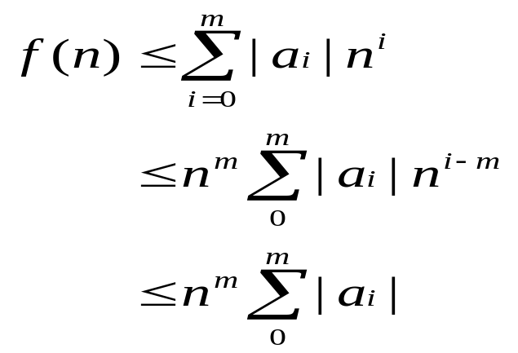
Asymptotic Notation (Cont.)
Theorem 1.2: If f(n) = a_{m}n^{m} + … + a₁n + a₀, then f(n) = O(n).
Proof:
for n ≥ 1
So, f(n) = O(n^{m})

Slide 52
Asymptotic Notation (Cont.)
Definition: [Omega] f(n) = Ω(g(n)) iff there exist positive constants c and n₀ such that f(n) ≥ cg(n) for all n, n ≥ n_{0.}
Example:
  3n + 2 = Ω(n)
  100n + 6 = Ω(n)
  10n² + 4n + 2 =Ω(n²)

Slide 53
Asymptotic Notation (Cont.)
Definition: f(n) = Θ(g(n)) iff there exist positive constants c₁, c₂, and n₀ such that c₁g(n) ≤ f(n) ≤ c₂g(n) for all n, n ≥ n₀.

Slide 54
Asymptotic Notation (Cont.)
Theorem 1.3: If f(n) = a_{m}n^{m} + … + a₁n + a₀ and a_{m} > 0, then f(n) = Ω(n).
Theorem 1.4: If f(n) = a_{m}n^{m} + … + a₁n + a₀ and a_{m} > 0, then f(n) = Θ(n).

Slide 55
Practical Complexities
If a program P has complexities Θ(n) and program Q has complexities Θ(n²), then, in general, we can assume program P is faster than Q for a sufficient large n.
However, caution needs to be used on the assertion of “sufficiently large”.

Slide 56
Function Values
log n | n | n log n | n² | n³ | 2^{n}
0 | 1 | 0 | 1 | 1 | 2
1 | 2 | 2 | 4 | 8 | 4
2 | 4 | 8 | 16 | 64 | 16
3 | 8 | 24 | 64 | 512 | 256
4 | 16 | 64 | 256 | 4096 | 65536
5 | 32 | 160 | 1024 | 32768 | 4294967296

Slide 57
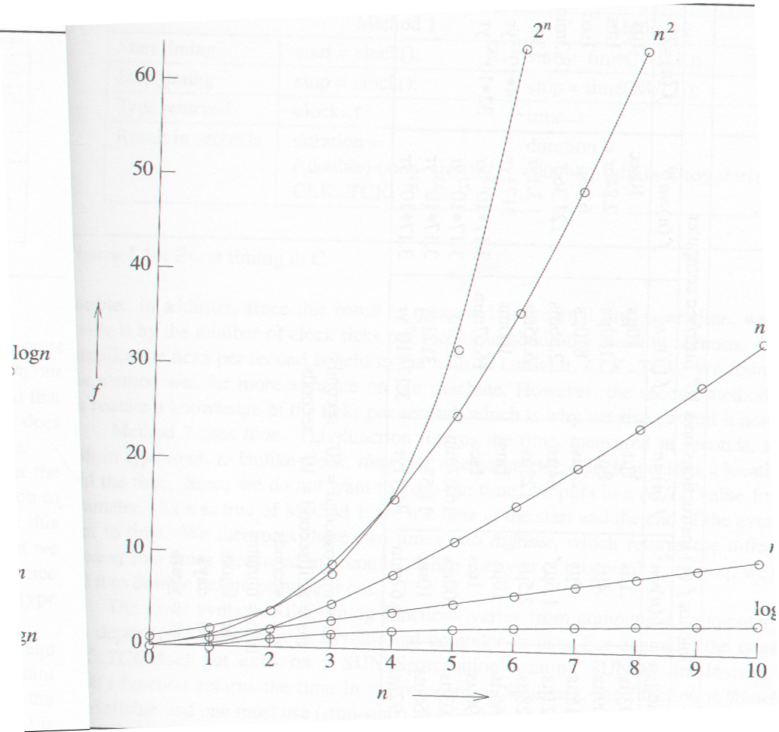
Plot of Function Values

Slide 58
Performance Measurement
Asymptotic analysis tells us the behavior only for “sufficiently large” values of n. For smaller values of n the run time may not follow the asymptotic curve.
The measured time plot may not lie exactly on the predicted curve due to the effects of lower terms.
To time a short event, it is necessary to repeat it several times and divide the total time for the event by the number of repetitions.
Clock precision is a factor

Slide 59
Program 1.23 Sequential Search
line int seqsearch (int *a, const int n, const int x) // a[0] … a[n]
{
int i = n; a[0] = x;
while (a[i] != x)
i--;
return;
}

Slide 60
Program 1.24
void TimeSearch () {
int a[1001], n[20];
for (int j = 1; j <= 1000; j++) // initialize a
a[j] = j;
for (j = 0; j < 10; j++) { // values of n
n[j] =10 * j; n[j+10] = 100 * (j+1);
}
cout << “ n totalTime runTime”<< endl;
for (j = 0; j < 20; j++) { // obatin computing times
long start, stop;
time(start); // start timer
int k = seqsearch(a, n[j], 0); // unsuccessful search
time(stop); // stop timer
long totalTime = stop – start;
float runTime = (float) (totalTime)/(float)(r[j]);
cout << “ “ << n[j] << “ “ << totalTime << “ “ << rutnTime << endl;
}
cout << Times are in hundredths of a second.” << endl;
}

Slide 61
Program 1.25 Timing Program
void TimeSearch () {
int a[1001], n[20];
const long r[20] = {300000, 300000, 200000, 200000, 100000, 100000,
100000, 80000, 80000, 50000, 50000, 25000, 15000, 15000, 10000, 7500, 7000, 6000,
5000, 5000 };
for (int j = 1; j <= 1000; j++) // initialize a
a[j] = j;
for (j = 0; j < 10; j++) { // values of n
n[j] =10 * j; n[j+10] = 100 * (j+1);
}
cout << “ n totalTime runTime”<< endl;
for (j = 0; j < 20; j++) { // obatin computing times
long start, stop;
time(start); // start timer
for (long b = 1; b<= r[j]; b++)
int k = seqsearch(a, n[j], 0); // unsuccessful search
time(stop); // stop timer
long totalTime = stop – start;
float runTime = (float) (totalTime)/(float)(r[j]);
cout << “ “ << n[j] << “ “ << totalTime << “ “ << rutnTime << endl;
}
cout << Times are in hundredths of a second.” << endl;
}

Slide 62
C++ Class
A class name
Data members
Member functions
Levels of program access
  Public: section of a class can be accessed by anyone
  Private: section of a class can only be accessed by member functions and friends of that class
  Protected: section of a class can only be accessed by member functions and friends of that class, and by member functions and friends of derived classes

Slide 63
Program 2.1 Definition of the C++ class Rectangle
#ifndef RECTANGLE_H
#define RECTANGLE_H
// In the header file
class Rectangle {
public: // The following members are public
Rectangle(); // Constructor
~Rectangle(); // Deconstructor
int GetHeight(); // return the height of the rectangle
int GetWidth(); // return the width of the rectangle
private: // The following members are private
int x1, y1, h, w;
// (x1, y1) are the coordinates of the bottom left corner of the rectangle
// w is the width of the rectangle; h is the height of the rectangle
};
#endif

Slide 64
Program 2.2 Implementation of operations on Rectangle
// In the source file Rectangle.C
#include “Rectangle.h”
// The prefix “Rectangle::” identifies GetHeight() and GetWidth() as member functions belong to class Rectangle. It is required because the member functions are implemented outside their class definition
int Rectangle::GetHeight() {return h;}
int Rectangle::GetWidth() {return w;}

Slide 65
Constructor and Destructor
Constructor: is a member function which initializes data members of an object.
  Adv: all class objects are well-defined as soon as they are created.
  Must have the same name of the class
  Must not specify a return type or a return value
Destructor: is a member fucntion which deletes data members immediately before the object disappears.
  Must be named identical to the name of the class prefixed with a tilde ~.
  It is invoked automatically when a class object goes out of scope or when a class object is deleted.

Slide 66
Examples of Constructor for Rectangle
Rectangle::Rectangle(int x, int y, int height, int width)
{
x1 = x; y1 = y;
h = height; w = width;
}
Rectangle::Rectangle(int x = 0, int y = 0, int height = 0, int width = 0)
: x1(x), y1(y), h(height), w(width)
{ }
Rectangle r(1, 3, 6, 6);
Rectangle *s = new Rectangle(0, 0, 3, 4);

Slide 67
Operator Overloading
C++ can distinguish the operator == when comparing two floating point numbers and two integers. But what if you want to compare two Rectangles?
int Rectangle::operator==(const Rectangle &s)
{
if (this == &s) return 1;
if ((x1 == s.x1) && (y1 == s.y1) && (h == s.h) && (w == s.w)) return 1;
else return 0;
}

